Slide 1
Association Rule Mining
Session 01
Brock Tibert
Notes:
No target we can find relation.

Slide 2
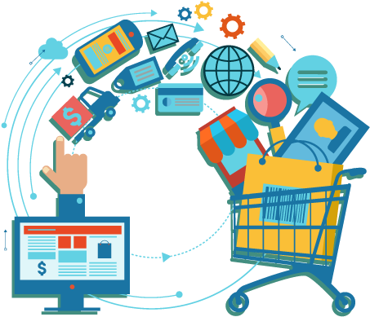
Outline for Today
Discuss the mechanics and delivery of the course
Base python versus External Packages
What we will cover and learn this semester
Topic 1: Association Rules for Pattern Discovery
Method/Approach
Evaluation
Applications
Hands on lab
I will use the terms Association Rules and Market Basket Analysis interchangeably

Slide 3
About Me
17 years applying “data science” in a variety of industries
Prior to joining the IS Faculty in Questrom I ran a small edtech firm
Interests are:
applied data science
graph analytics
product management
Sports analytics
applications of text mining (Conversational agents)

Slide 4

My
Dog
Bodhi
(Most of the time)

Slide 5

My
Dog
Bodhi
(sometimes)

Slide 6
Course Delivery Overview

Slide 7

Details on setup will be provided later this week

Slide 8

Our class sessions will be recorded for review on demand. The recordings should be posted automatically after the recorded session has finished processing. These can be found on QuestromTools.

Slide 9


The majority of the resources will be found in the class repo
I will post our lecture notes there, and add content as we go through the semester, so pull changes often!
Discussions
We will build on prior classes and use Google Cloud tools
Big Query to query our datasets
I encourage you to use this course to continue to practice your cloud skills!

Slide 10



Whatever environment works for you is 100% ok with me
I will mostly write code in VS Code, but may hop into Colab for certain modules
Notebook environments are great for exploration, but the non-linear flow can be a source of bugs/error
Deploying our work as data scientists (more often than not) requires that we have structure in our projects, which is why I encourage you to get comfortable outside of notebooks*
* papermill is the exception

Slide 11






Slide 12
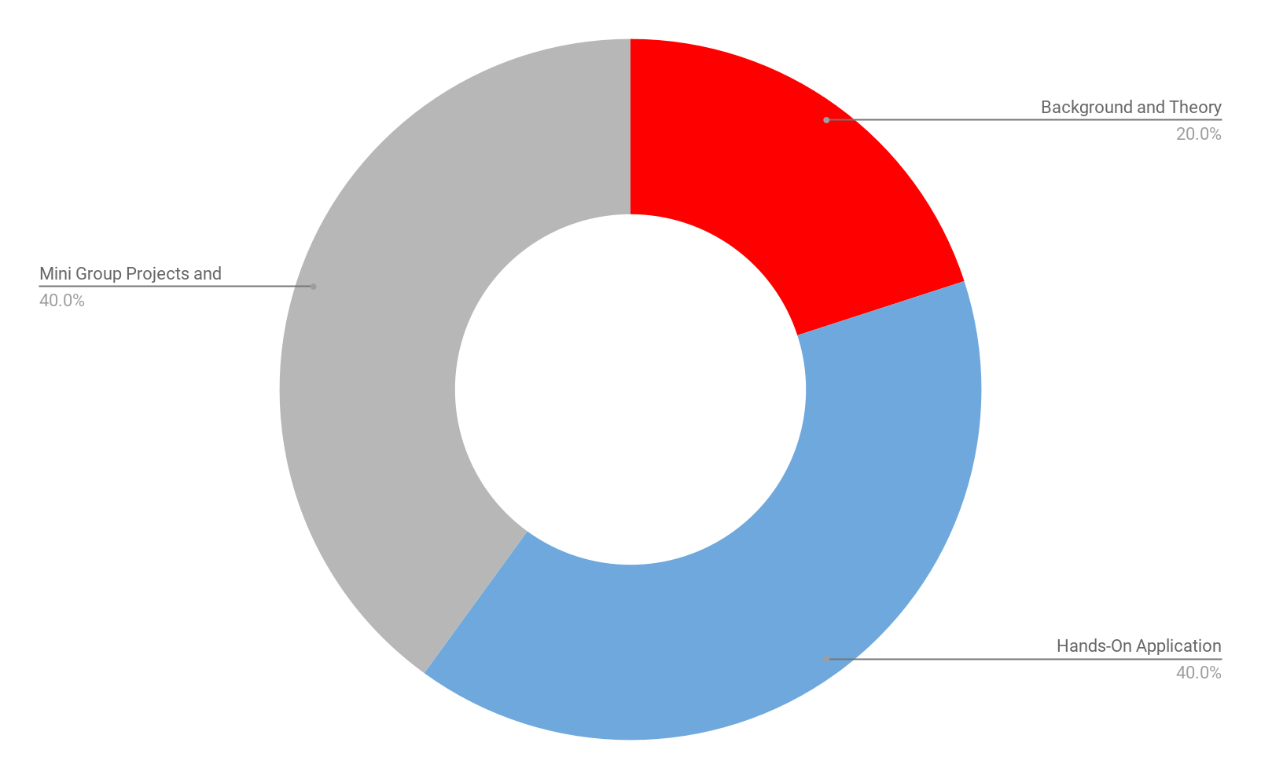
Composition of the Course
Learning through coding up solutions!

Slide 13
Course Delivery
Discuss the method and the mechanics/understanding of how it works
Explore the tools available to us in the python ecosystem
Build mental models of how to include each technique into a larger analytics project, with a focus on reporting technical results to a nontechnical audience
In-class Exercises / Case Studies / Competitions to be completed as teams
Yes we will write code, but it's about coding up the model AND interpreting/presenting the findings

Slide 14
Overview
Class preparation makes these advanced topics, especially when we are writing code, easier in the long run. I do leave it to you, though, to determine what works best for your learning style
DataCamp review and practice
I will record supplemental videos
Github Repository
Discussions (you get credit!) and peer-to-peer support
Cheat Sheets and resources to supplemental readings
Supplemental books listed in the syllabus
You will leave this class with the ability to build both write code to solve analytical challenges, and discuss your findings with a variety of audiences
It's about understanding the methods, applying them, and telling a story of the results. Why does it matter? Are we introducing risk/uncertainty into the business?

Slide 15
Beyond base python

Slide 16
Moving Forward
I am certain by now you are increasingly comfortable with python and tools like pandas
We will be using a large number of external packages this course
Please use the Discussion forums on Github for help with installation and setup of these packages, though a number do come pre-configured on Colab
There are many, many ways to attack some of the problems that we are doing, and some may be handled differently in DataCamp. That's ok!
Exposure to what is possible and a variety of ways to solve the problem is important!

Slide 17
What we will be covering in BA820
Unsupervised Machine Learning
Association Rules (~ Reco Engines)
Clustering Segmentation Methods
Dimensionality Reduction/Embeddings
Text Analytics
Text Pre-processing
Sentiment Analysis
Text Classification and Clustering
NLP
Unsupervised Machine Learning helps identify structure and patterns in our datasets, which also can be used to generate features downstream supervised ML tasks.
The majority of the data we generate on a daily basis is unstructured. We will learn how the foundation of Natural Language Processing and Understanding (NLP/NLU) and see how both UML and SML techniques still apply to text!

Slide 18
Market Basket Analysis Overview

Slide 19

Market Baskets
A classic application of market basket analysis addresses this question:
Which items are likely to be purchased together?
If product A and product B often go together, then placing a more expensive alternative to B near the display for A can create an upsell opportunity.
If product A and B are often purchased together, putting one item on sale at a time can drive purchases for both.

Slide 20

Hardware Store Example
A hardware store has 25 shopping aisles. To help customers find product easily, which products should be placed near one another?
Key-cutting near paint or near door hardware?
Lawn ornaments near garden or near indoor decorative ornaments?
Could be harder to rely on intuition to figure out

Slide 21
Association Rules can be used as simple recommendation engine but is more commonly thought as a pattern recognition technique to surface "if this, than that" type of rules.
What it is:
Find patterns in transactional data in order to determine the co-occurence, or association, between items.
What it does:
Given a known set of items (LHS), what other items (RHS) tend to co-occur with the LHS
What it means:
We can leverage the RHS items and treat these as recommendations given the LHS.

Slide 22
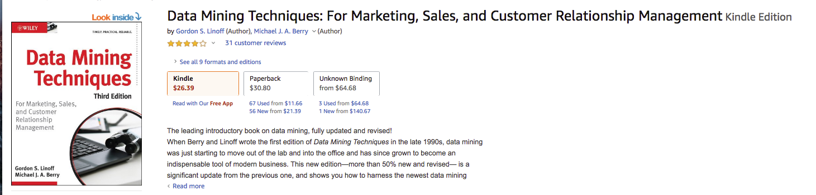
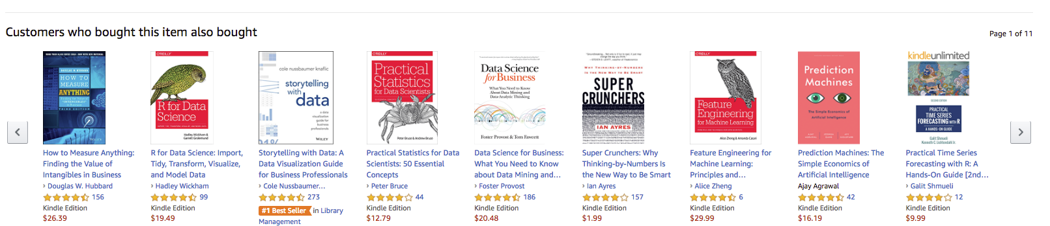

Slide 23
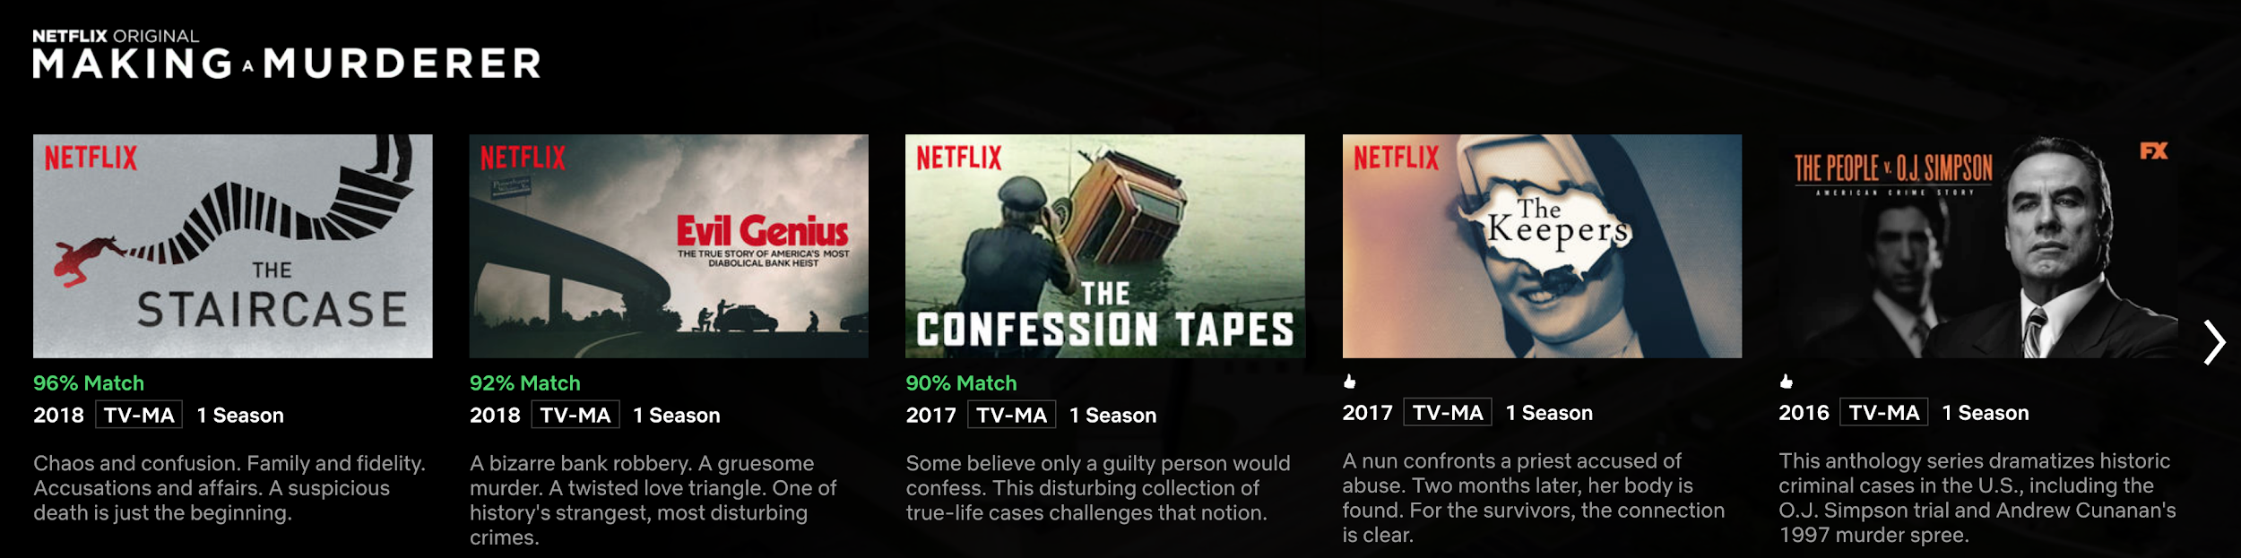
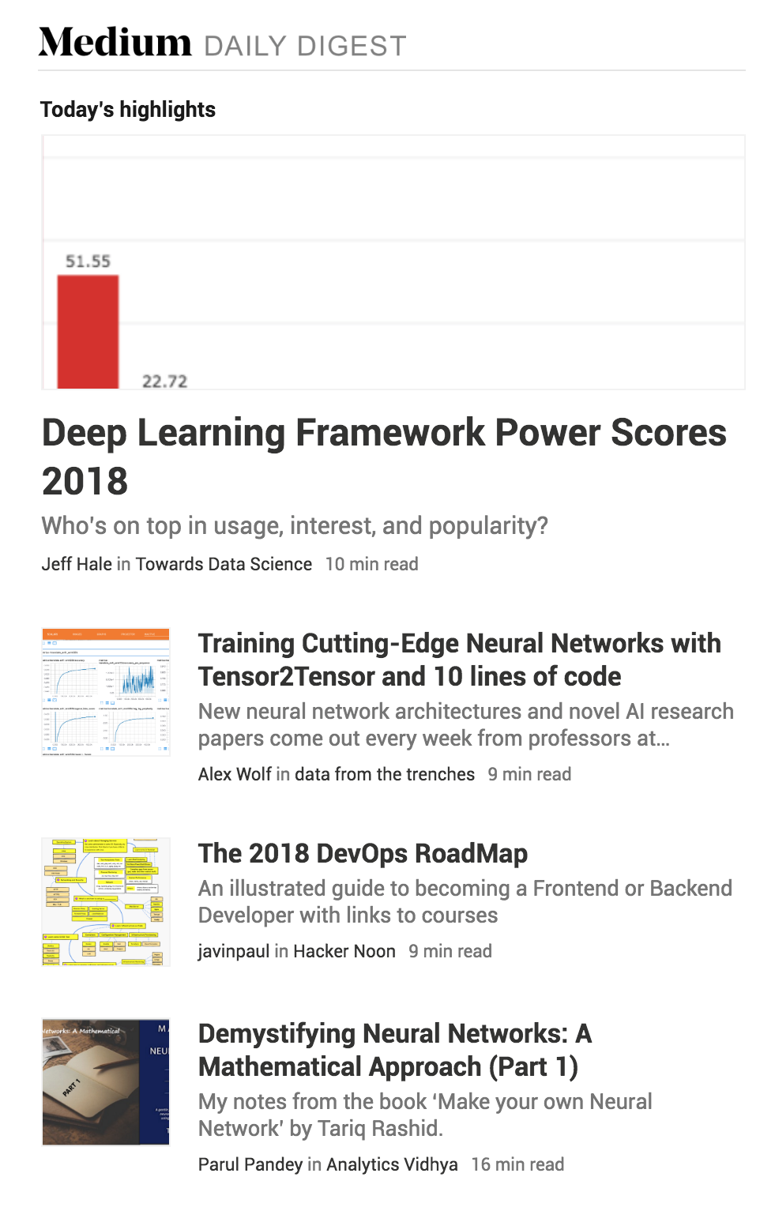
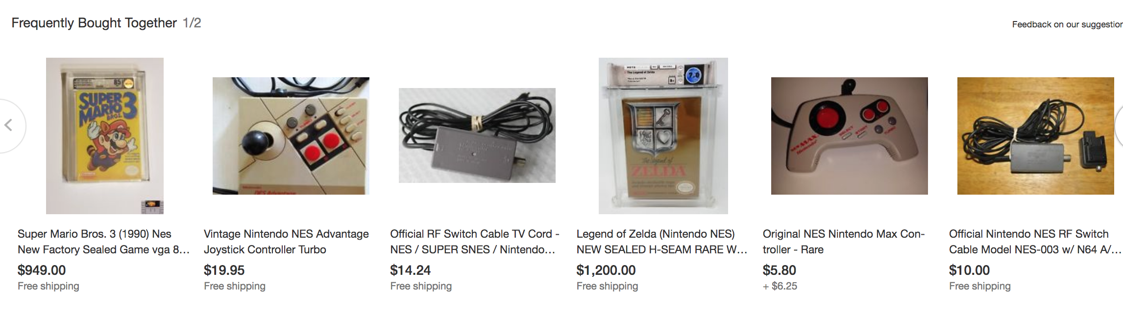
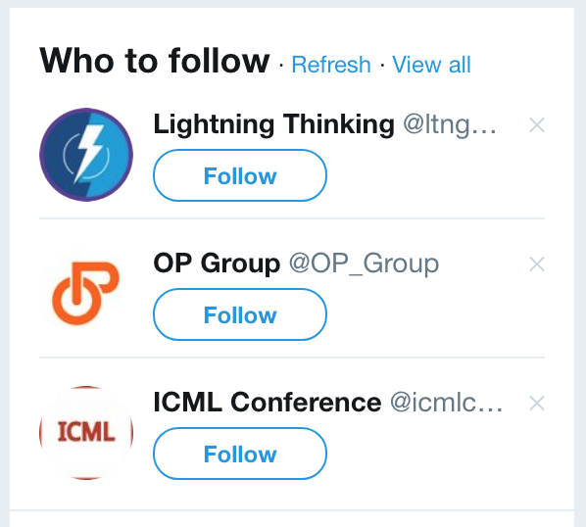
Other Examples?

Slide 24
The Algorithm
This approach is popular because it’s fairly simple to frame for non-technical decision makers.
We will be using the Apriori algorithm. This is found within the frequent patterns module in the mlxtend package.
Identify all items (and subsequently, itemsets) that meet certain thresholds, such as a minimum number of times an item must appear across all of the transactions
Generate rules from the Frequent itemsets. These rules must also meet certain criteria such as how many times they appear in the transactions.
The apriori algorithm needs to perform full scans of the database to evaluate candidate itemsets and rules. This can be computationally intensive on larger datasets and the total number of items to consider.
Notes:
Breadth first versus depth first. FPGrowth helps with reducing the passes on the dataset.
https://analyticsindiamag.com/apriori-vs-fp-growth-in-market-basket-analysis-a-comparative-guide/#:~:text=Apriori%20uses%20candidate%20generation%20where,every%20item%20in%20the%20data.&text=FP%2Dtree%20requires%20only%20one,so%20it%20consumes%20less%20time.

Slide 25
Terminology
Items: The set of objects or items available to be purchased, or viewed, or streamed.
Transaction: A trip to the store, Netflix viewing history, your most recent Spotify songs streamed. A transaction contains one or more items.
Rule: Can be considered an if this then that.
If purchase bread and eggs, then also purchase milk.
{Bread, Eggs} => {Milk}
LHS, or antecedent: Left-hand side of the rule
The known set of objects. {Bread, Eggs}
RHS, or consequent: The items that are associated, or co-occur with the LHS
Above, this would be {Milk}.
(Frequent) Itemset: A collection of one or more items.

Slide 26
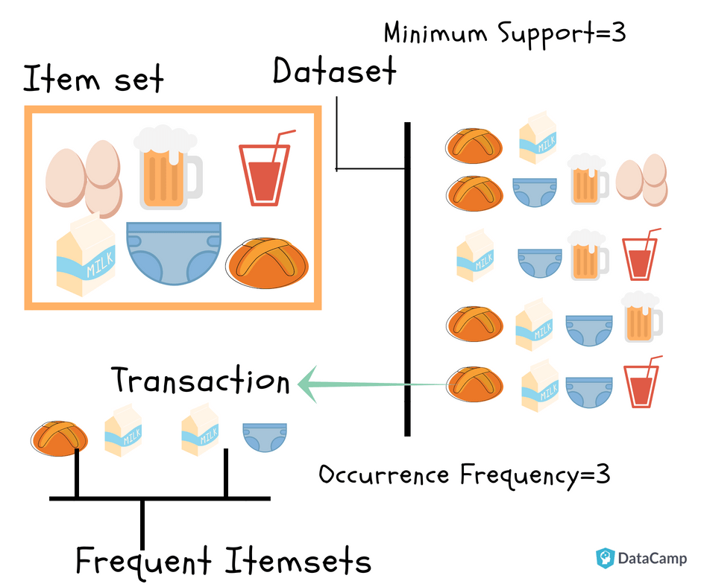
A Visual Reference
The dataset of transactions is on the right
Items = eggs, milk, bread, beer, diapers, cola
Itemsets are a collection of k-items (usually 2 or more)
Frequent Itemsets are itemsets that are common across the transactions and meet our thresholds for support and confidence.
You also see two new terms; Support and Frequency. As you can imagine, Association rules are built on top of statistics and we uses these metrics to guide our decision making to find interesting rules. We will come back to the evaluation in a moment.
Notes:
https://www.datacamp.com/community/tutorials/market-basket-analysis-r

Slide 27
Let’s see this in action

Slide 28
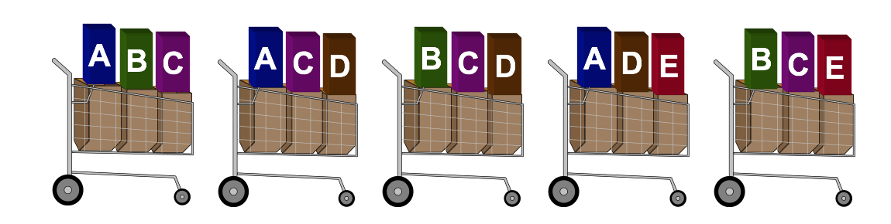
Market Basket Analysis: Support
Support (A=> B) =
transactions containing {A,B}
all transactions
Interpretation:
For all of the transactions in the dataset, how frequently does the itemset {A,B} occur

Slide 29
Market Basket Analysis: Confidence
Confidence (A=> B) =
transactions containing {A,B} = Support {A,B}
transactions containing A = Support {A}
Interpretation:
For all of the transactions containing LHS A, how confident are we that the rule/transaction also includes RHS B is true.

Slide 30
Market Basket Analysis: Lift
Lift (A=> B):
transactions containing {A,B} = Support {A,B}
Support {A} * Support {B}
Interpretation:
Often considered a quality measure for a rule. Lift > 1 is how much better we are predicting {B} than just knowing support {B}. Higher values indicate more effective rules in predicting RHS
Lift = 1 suggests independence between {A} and {B}
Lift is very similar correlation (general measure of association between two itemsets). It doesn’t change if you swap the LHS / RHS
Notes:
https://www-users.cs.umn.edu/~kumar001/dmbook/ch6.pdf == search for lift
https://stats.stackexchange.com/questions/229523/association-rules-support-confidence-and-lift == plain english description

Slide 31
Calculate the Metrics
Rule | Support | Confidence | Lift
A => D | ⅖ =.4 | 2/3 | (⅖)/ (⅗)*(⅗) = 1.11
C => A | 2/5 | 2/4 | (2/5)/ (3/5)*(4/5)
A => C | 2/5 | 2/3 | (2/5)/(3/5)*(4/5)
B & C => D | 1/5 | 1/3 | (1/5)/ (3/5)*(3/5)
Notes:
Support - how often do all items exist from all transactions
Confidence - for left hand side, how often does the right exist
Lift Support of all items / product of support of each item

Slide 32
Your Turn

Slide 33
Calculate the Metrics
Rule | Support | Confidence | Lift
A => D | ⅖ =.4 | 2/3 | (⅖)/ (⅗)*(⅗) = 1.11
C => A | 2 / 5 | 2 / 4 | .4 / (⅘)*(⅗) = .833
A => C | 2 / 5 | 2 / 3 | .4 / (⅗)*(⅘)=.833
B & C => D | 1 / 5 | 1 / 3 | .2 / (⅗)*(⅗) = .555
Notes:
Support - how often do all items exist from all transactions
Confidence - for left hand side, how often does the right exist
Lift Support of all items / product of support of each item

Slide 34
Thought Experiment:
Stepping back, as an analyst trying to solve a business problem, how can we combine Support / Confidence / Lift in relationship the rules?

Slide 35
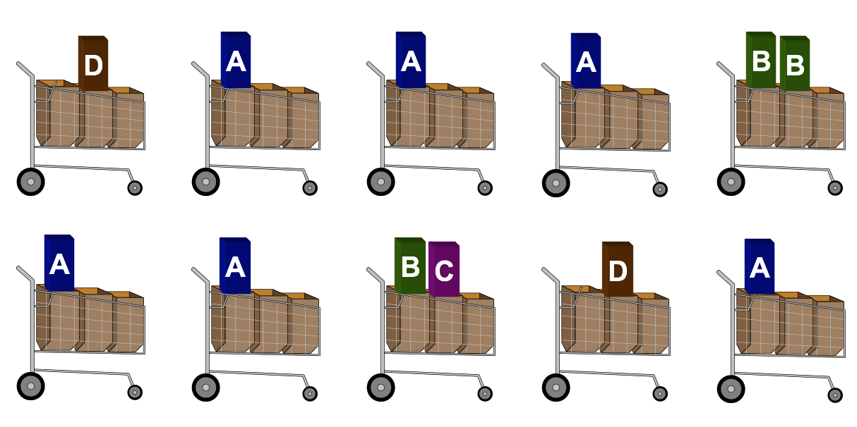
Does the data support Market Basket Analysis
We need data with collection of items, if minimal, association rules are probably not a good technique

Slide 36
Some Parting Notes
Rules need to be actionable (not very rare, but this is also debatable)
Rules are not causation, but help us find patterns of co-occurrence
Rules can be symmetric, so it often helps to frame the problem in the context of the LHS or RHS
I tend to frame relative to the RHS
To sell more of the RHS, find the itemsets in the LHS to help build strategies for upsell or cross-promotion

Slide 37
But what does a dataset look like?

Slide 38
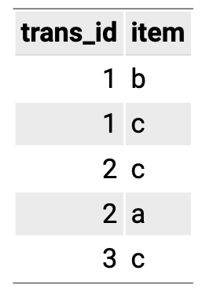
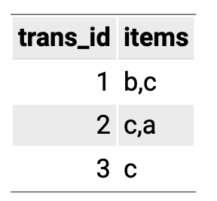
The transactional datasets can vary in how they are stored
Basket format
Single format
Luckily, python/pandas make it really easy to modify the origin source data to fit the libraries expected format

Slide 39
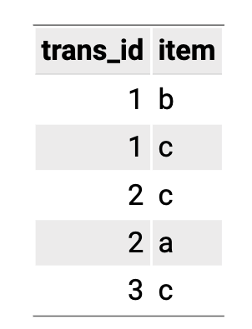
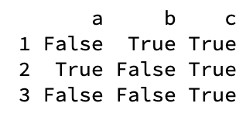
The mlxtend format
What do you notice about the dataset on the right?

Slide 40
Let’s write some python!

